Slide 1
4
Program Control
Objectives
In this chapter, you’ll:
Learn the essentials of counter controlled iteration.
Use the for and do…while iteration statements to execute statements repeatedly.
Understand multiple selection using the switch selection statement.
Use the break and continue statements to alter the flow of control.
Use logical operators to form complex conditions in control statements.
Avoid the consequences of confusing the equality and assignment operators.

Slide 2
4.1 Introduction
You should now be comfortable with reading and writing simple C programs. Next, we consider iteration in more detail and introduce C’s for and do…while iteration statements. We also introduce:
the switch multiple-selection statement,
the break statement for exiting immediately from certain control statements, and
the continue statement for skipping the remainder of an iteration statement’s
body then proceeding with the next iteration of the loop.

Slide 3
4.2 Iteration Essentials
Most programs involve iteration (or looping). A loop is a group of instructions the computer repeatedly executes while some loop-continuation condition remains true. We’ve discussed two means of iteration:
Counter-controlled iteration.
Sentinel-controlled iteration.
Counter-controlled iteration uses a control variable to count the number of iterations for a group of instructions to perform.
On the other hand sentinel values is used to control iteration if the precise number of iterations isn’t known in advance in sentinel-controlled iteration

Slide 4
4.3 Counter-Controlled Iteration
Counter-controlled iteration requires:
the name of a control variable,
the initial value of the control variable,
the increment (or decrement) by which the control variable is modified in each iteration, and
the loop-continuation condition that tests for the final value of the control variable to determine whether looping should continue.

Slide 5
4.3 Counter-Controlled Iteration

Slide 6
4.4 for Iteration Statement

Slide 7
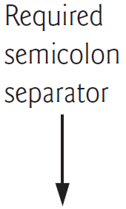
4.4 for Iteration Statement

Slide 8
4.4 for Iteration Statement

Slide 9
4.4 for Iteration Statement

Slide 10
4.4 for Iteration Statement

Slide 11
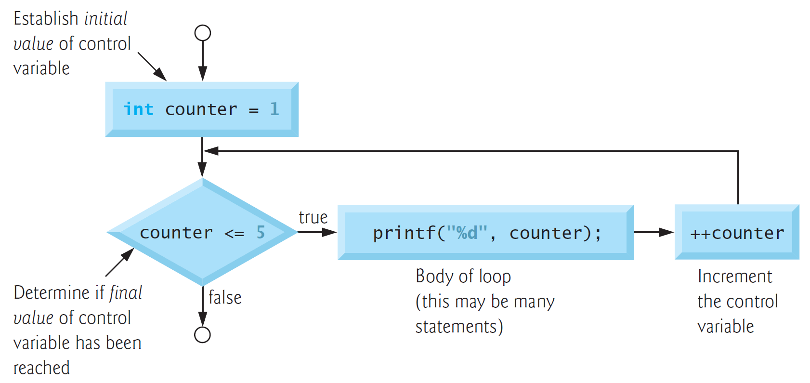

4.4 for Iteration Statement
General Format of a for Statement
The general format of the for statement is
for (initialization; loopContinuationCondition; increment) {
statement
}

Slide 12
4.4 for Iteration Statement
General Format of a for Statement
The general format of the for statement is
for (initialization; loopContinuationCondition; increment) {
statement
}

Slide 13
4.4 for Iteration Statement
General Format of a for Statement
The general format of the for statement is
for (initialization; loopContinuationCondition; increment) {
statement
}

Slide 14
4.4 for Iteration Statement
General Format of a for Statement
The general format of the for statement is
for (initialization; loopContinuationCondition; increment) {
statement
}

Slide 15
4.4 for Iteration Statement
General Format of a for Statement
The general format of the for statement is
for (initialization; loopContinuationCondition; increment) {
statement
}

Slide 16
4.4 for Iteration Statement
General Format of a for Statement
The general format of the for statement is
for (initialization; loopContinuationCondition; increment) {
statement
}

Slide 17
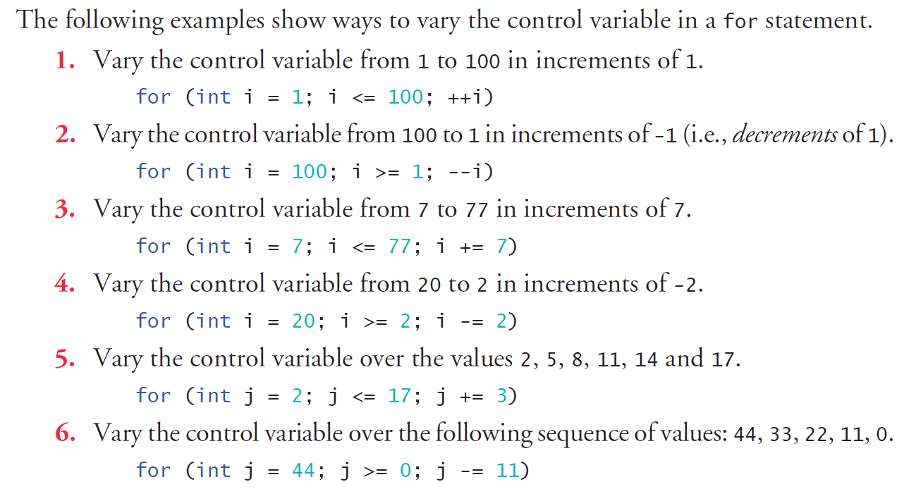
4.5 Examples Using the for Statement

Slide 18
4.5 Examples Using the for Statement

Slide 19
4.5 Examples Using the for Statement

Slide 20
4.5 Examples Using the for Statement

Slide 21
4.5 Examples Using the for Statement

Slide 22
4.5 Examples Using the for Statement

Slide 23
4.5 Examples Using the for Statement

Slide 24
4.5 for Iteration Statement
Application: Summing the Even Integers from 2 to 100

Slide 25
4.5 for Iteration Statement
Application: Compound-Interest Calculations
The next example computes compound interest using the for statement. Consider the following problem statement:
A person invests $1000.00 in a savings account yielding 5% interest. Assuming all interest is left on deposit in the account, calculate and print the amount of money in the account at the end of each year for 10 years. Use the following formula for determining these amounts:
a = p(1 + r)n
where
p is the original amount invested (i.e., the principal, $1000.00 here),
r is the annual interest rate (for example, .05 for 5%),
n is the number of years, which is 10 here, and
a is the amount on deposit at the end of the nth year.

Slide 26
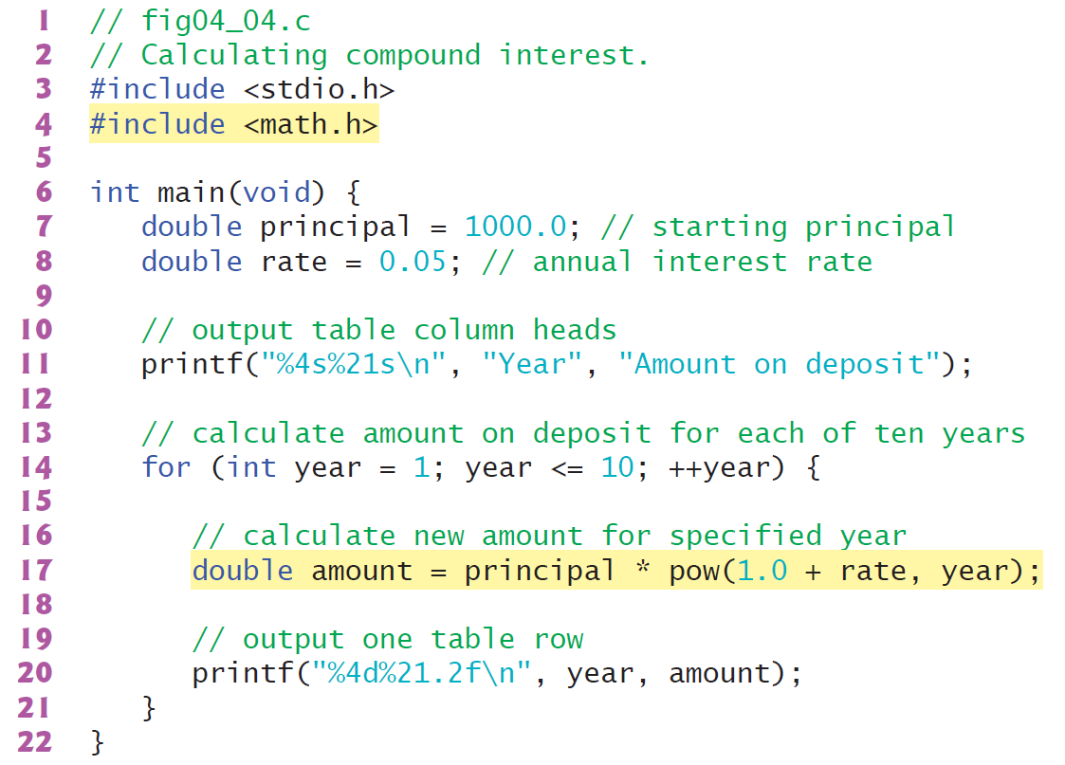
4.5 for Iteration Statement
Application: Compound-Interest Calculations

Slide 27
4.6 switch Multiple-Selection Statement
We discussed the if single-selection and the if…else double-selection statements.
Occasionally, an algorithm will contain a series of decisions that test a variable or expression separately for each of the integer values it may assume, then perform different actions. This is called multiple selection.
C provides the switch multiple-selection statement to handle such decision making.
The switch statement consists of a series of case labels, an optional default case and statements to execute for each case.

Slide 28
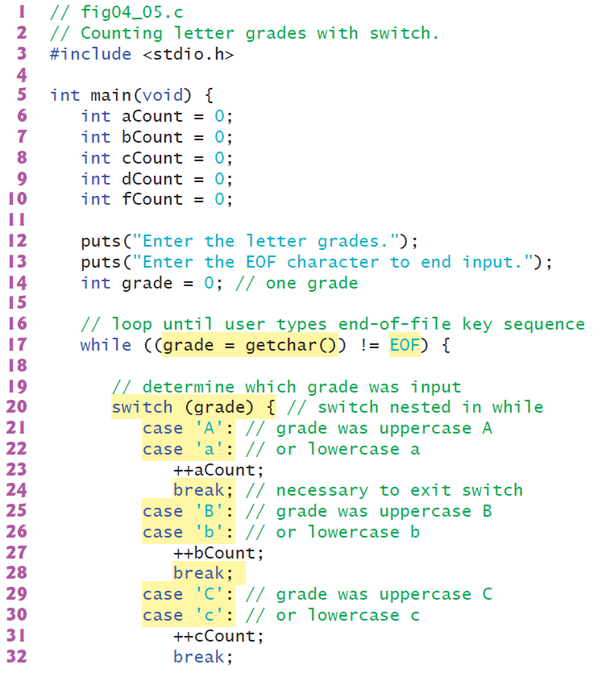
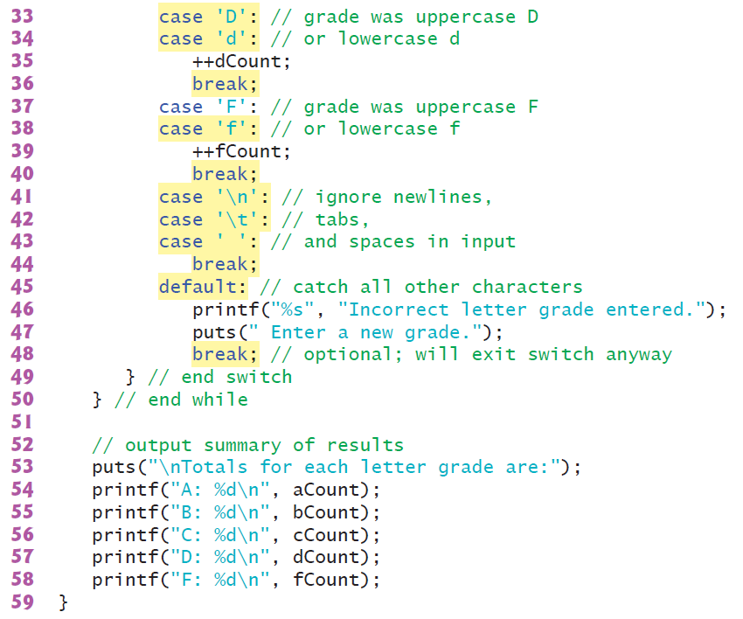
4.6 switch Multiple-Selection Statement

Slide 29
4.6 switch Multiple-Selection Statement

Slide 30
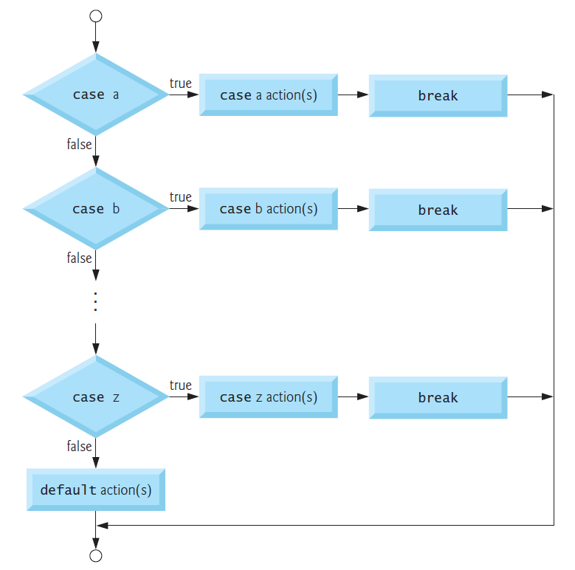
4.6 switch Multiple-Selection Statement
switch Statement Flowchart

Slide 31
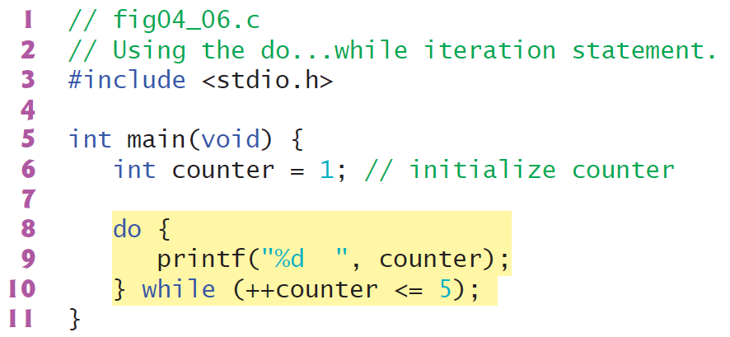
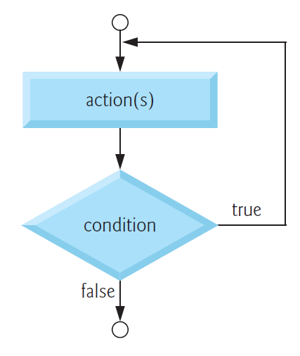
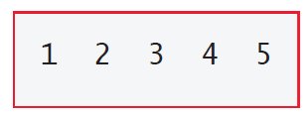
4.7 do…while Iteration Statement
The do…while iteration statement is like the while statement.
The while statement tests its loop-continuation condition before executing the loop body.
The do…while statement tests its loop-continuation condition after executing the loop
body, so the loop body always executes at least once.
do…while Statement Flowchart

Slide 32
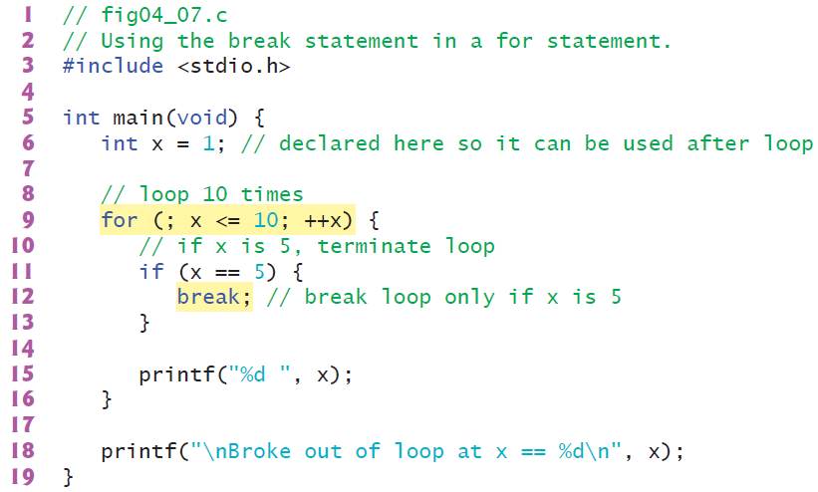
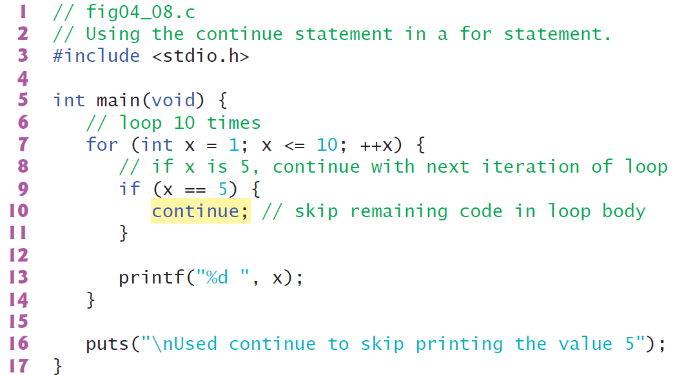
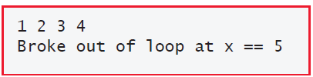
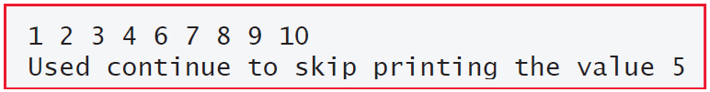
4.8 break and continue Statements
The break and continue statements are used to alter the flow of control.
continue Statement
The continue statement, when executed in a while, for or do…while statement, skips the remaining statements in that control statement’s body and performs the next iteration of the loop.
break Statement
The break statement, when executed in a while, for, do…while or switch statement, causes an immediate exit from that statement.

Slide 33


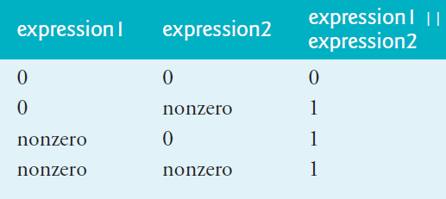
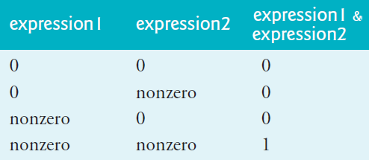
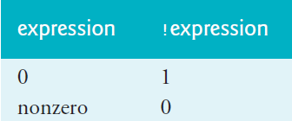

4.9 Logical Operators
Logical AND (&&) Operator
Logical Negation (!) Operator
Logical OR (||) Operator

Slide 34
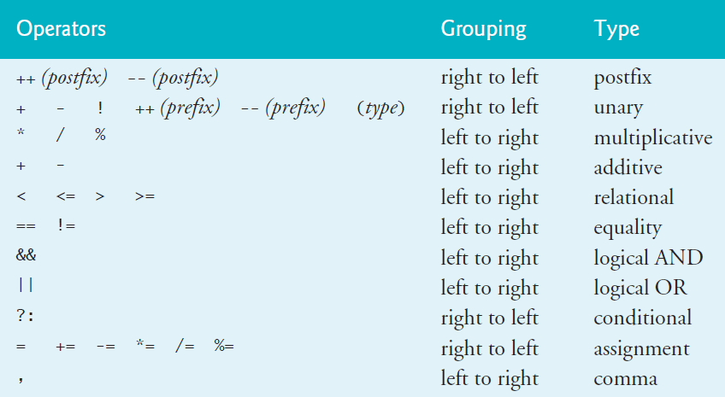
Summary of Operator Precedence and Grouping

Slide 35
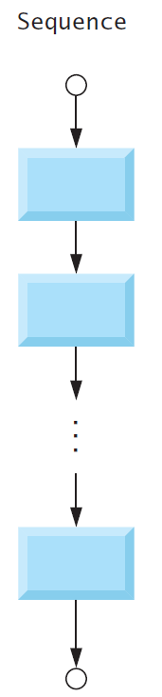

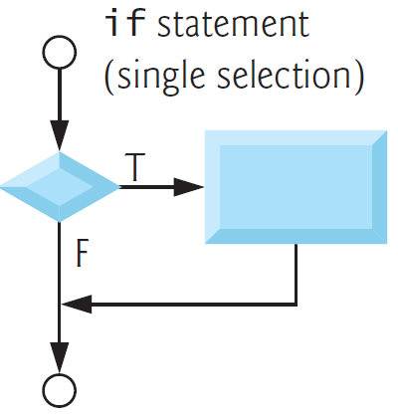
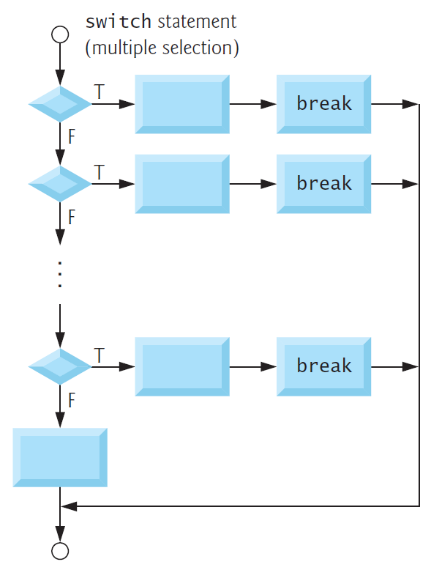
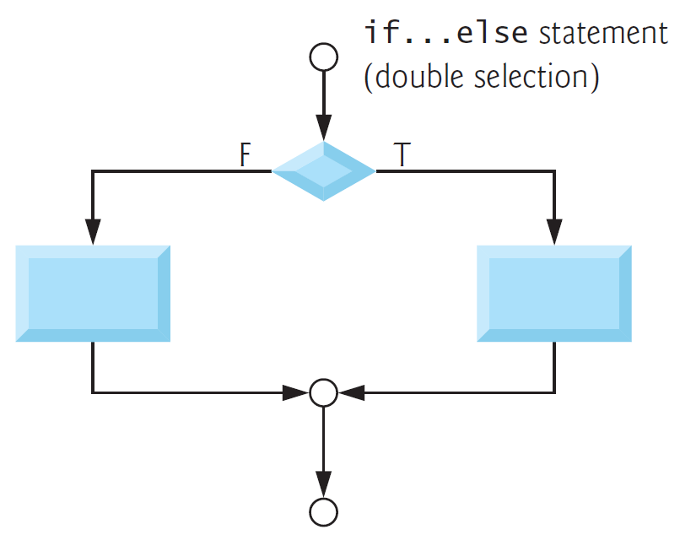
4.11 Structured-Programming Summary

